Slide 1
Capstone project – 3 pytHon finance tracker
Done by:
KIRUTHIK. A

Slide 2
Introduction
This project is based on managing personal finance using Python.
Includes expense tracking, savings calculation, OOP, file handling, loops, functions.
Based fully on your uploaded code.

Slide 3
Project Objective
The objective of this project is to develop a simple and effective Python-based Personal Finance Tracker that helps users record, calculate, and analyze their monthly expenses.
The system aims to automate the process of expense management by collecting user inputs, computing total spending, determining savings, and classifying the user’s financial status.
Overall, the key objective is to provide users with a clear financial overview that supports better budgeting, spending control, and financial awareness.

Slide 4
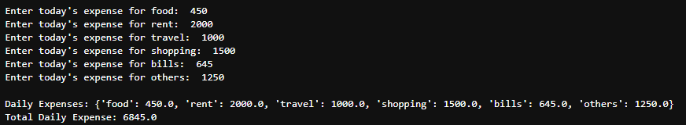
Requirement 1– Expense Recording System
User enters daily expenses. Interpretation :
Stored in a dictionary. It stores all the expenses in the
Calculates total daily expense. Dictionary and it sum it all using
Uses: loops, dictionary, input(). Sum() function.
OUTPUT :

Slide 5
Requirement 2 – Monthly Expense Analyzer
Function monthly analysis() receives 30‑day list . Interpretation :
Returns: It calculates the list of daily
- Total monthly expense expenses.
- Average daily expense
- Highest spending day
- Lowest spending day
Demonstrates use of lists & functions.
OUTPUT :

Slide 6

Requirement 3 – Conditional Savings Calculator
Inputs: monthly income & expenses. Interpretation :
Calculates savings. The user asks the monthly income and
Uses if‑elif‑else to classify: expenses and it show you the type of
- Excellent Saver saving.
- Moderate Saver
- Poor Saver
Demonstrates conditional statements.
OUTPUT :

Slide 7

requirement 4 – Expense List Processing
Given weekly list of expenses. Interpretation :
Loop extracts values > 500. We can fetch the expenses which we
Calculates count, total, average. are Spending more than an particular
• Shows list filtering using loops. amount.
OUTPUT :

Slide 8
requirement 5 – Budget Advice Function
Inputs: income, rent, food, transport. Interpretation :
Checks percentage of income spent. It is used to find the high expenses
• Returns suggestion: which we are doing.
- Reduce rent
- Control food spending
- Transport cost high
- Good budget management
OUTPUT :

Slide 9

requirement 6 – Tuples & Sets Operations
Fixed & variable expense tuples. Interpretation :
• Converted to sets. It finds the common spending
• Finds: category and it finds the
- Common items unnecessary spendings.
- Unique items in each.
• Demonstrates set theory in Python.
OUTPUT :

Slide 10

requirement 7 – Financial Profile Class
Class Finance Profile created. Interpretation :
Attributes: name, income, expense. It shows the person who are
Methods: spending more amount and who all
- calculate_savings() are saving the amount.
- spending_status()
• Shows OOP fundamentals.
OUTPUT :

Slide 11

requirement 8 – File Handling
Writes weekly expenses into expenses.txt Interpretation :
Reads file The expenses we are spending will
Calculates weekly total be saved as an txt file.
Includes error handling:
- File not found
- Reading error
OUTPUT :

Slide 12

requirement 9 – Expense Tracker Class
OOP with multiple attributes: Interpretation :
name, income, rent, food, transport, others. It calculates the total expenses
Methods: and it shows how much
- total_expense() amount you are saving.
- savings()
- status()

Slide 13
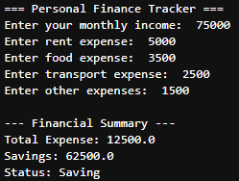
REQUIREMENT 10 – Final Finance Program
User enters income, rent, food, transport. Interpretation :
Functions calculate total & status. User ask your salary and your
• Displays: expenses amount and display your
- Total Expense balance savings amount.
- Savings
- Spending Status
OUTPUT :

Slide 14
Python Concepts Used
Variables & Data Types
Lists, Dictionaries, Tuples, Sets
• Loops (for/while)
Conditional statements
Functions
File handling
Object‑Oriented Programming

Slide 15
Real‑Life Applications
Personal budget tracking
Banking & finance apps
Household planning tools
Monthly savings calculators

Slide 16
CONCLUSION
The Python Personal Finance Tracker project successfully demonstrates how simple programming concepts can be applied to solve real-life financial management problems.
By automating the calculation of expenses, savings, and spending status, the system provides users with a clear understanding of their monthly financial behavior..
Overall, this project highlights the importance of financial awareness and showcases Python’s capability in building meaningful, everyday applications.

Slide 17
Thank You !

